Slide 1
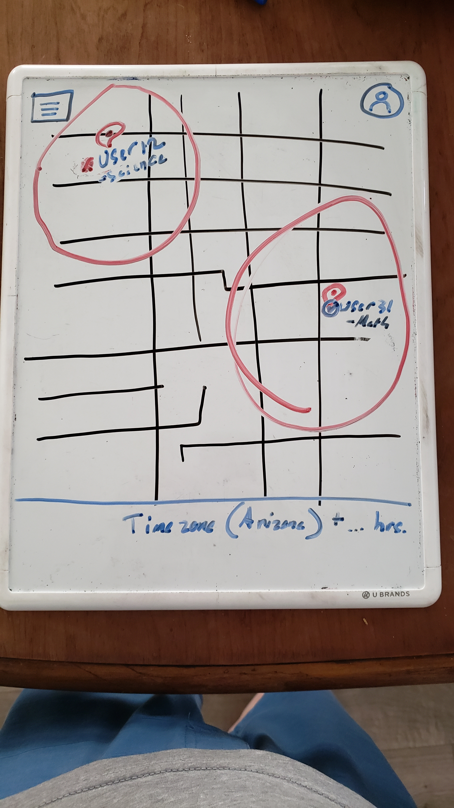
Menu Button upper left
User Account Button
“(availability) TutorUsername”
-Topic
Red circle = Tutor zipcode for TimeZone data
User’s current TimeZone

Slide 2
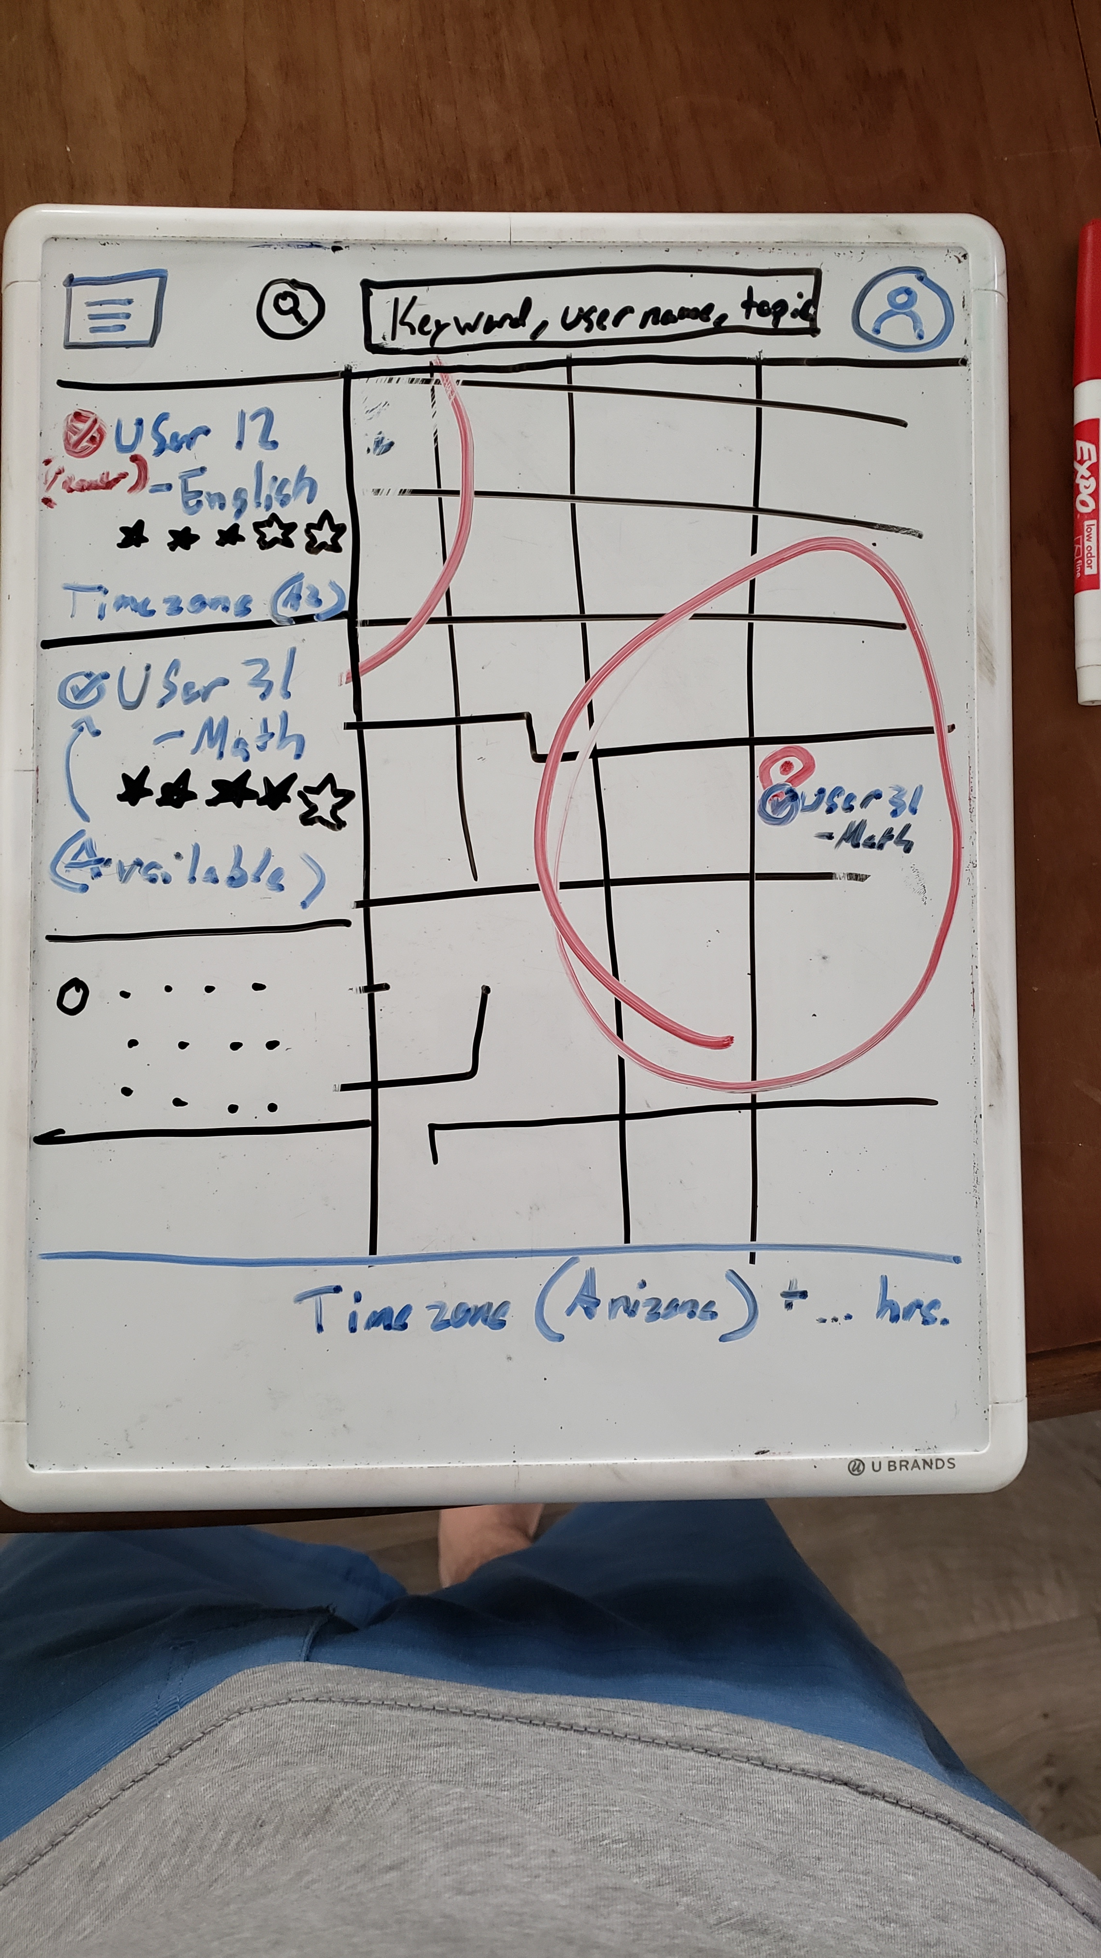
Search Button
*clicked*
Menu Button upper left
User Account Button
Search Bar
*Menu clicked*
“(availability) TutorUsername”
-Topic
Red circle = Tutor zipcode for TimeZone data
“(availability) TutorUsername”
-Topic
R A T I N G
“(Checkmark) User31 ”
-English
* * * * _
“(availability) TutorUsername”
-Topic
R A T I N G
User’s current TimeZone

Slide 3
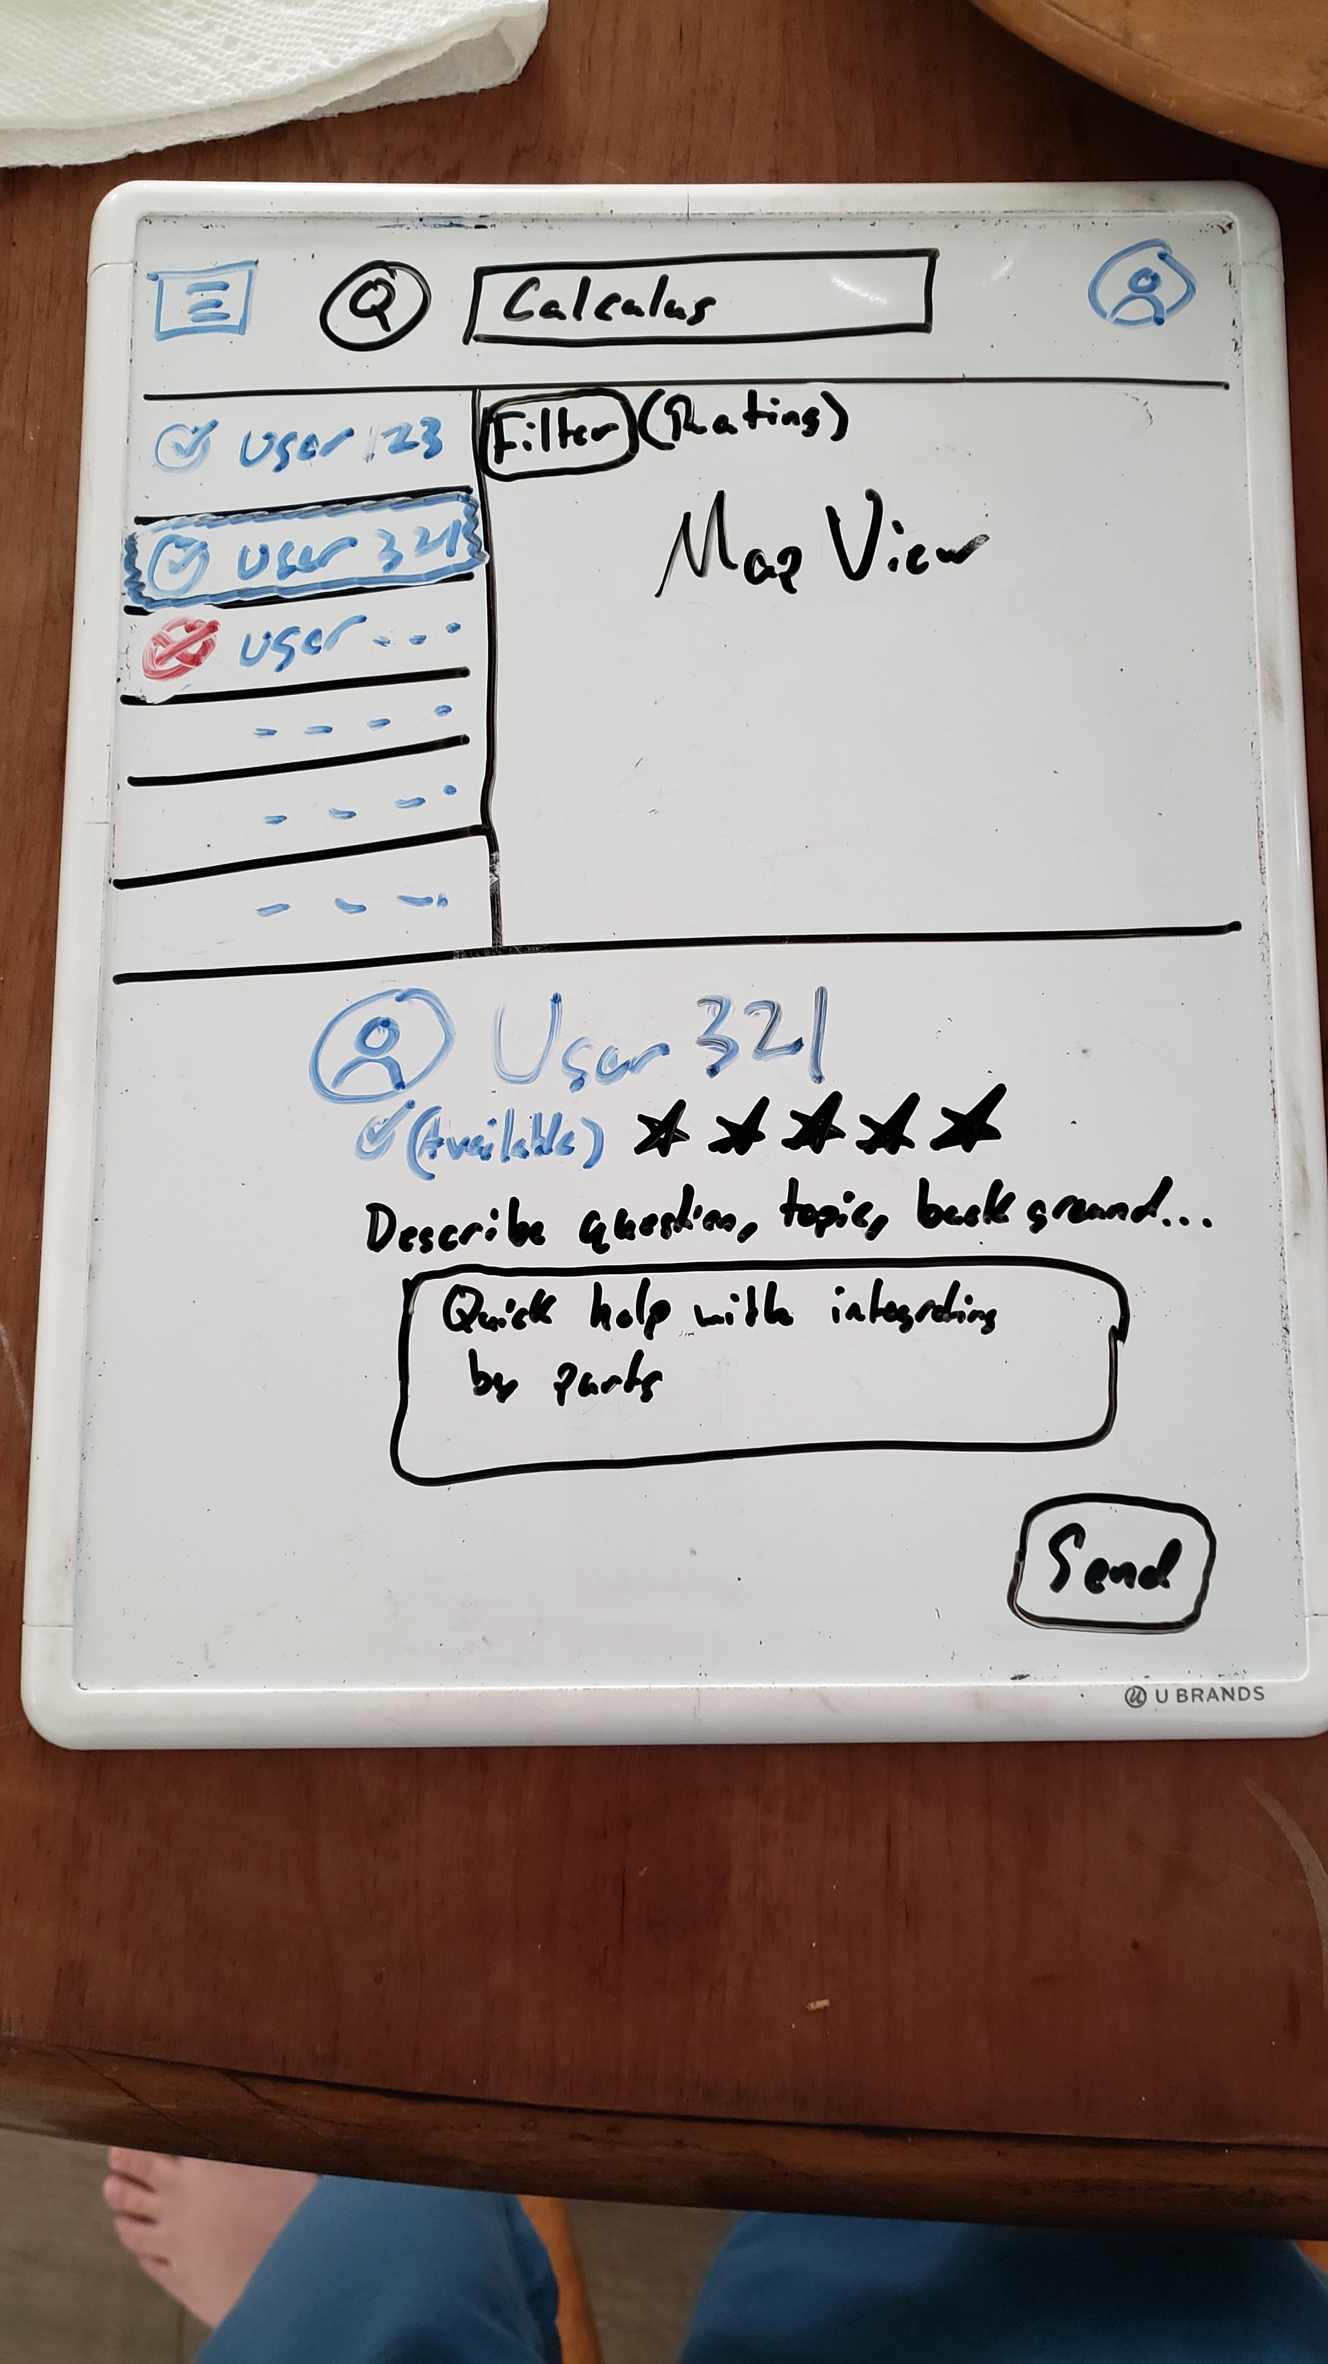
Search Button
*clicked*
Menu Button upper left
User Account Button
Search Bar
*Menu clicked*
Filter Button
“(availability) TutorUsername”
-Topic
R A T I N G
“(Checkmark) User31 ”
-English
* * * * _
Tutor info:
“(picture) TutorUsername”
(availability) R A T I N G
“(availability) TutorUsername”
-Topic
R A T I N G
Textbox, send tutor question or description of problem
Send Button

Slide 4
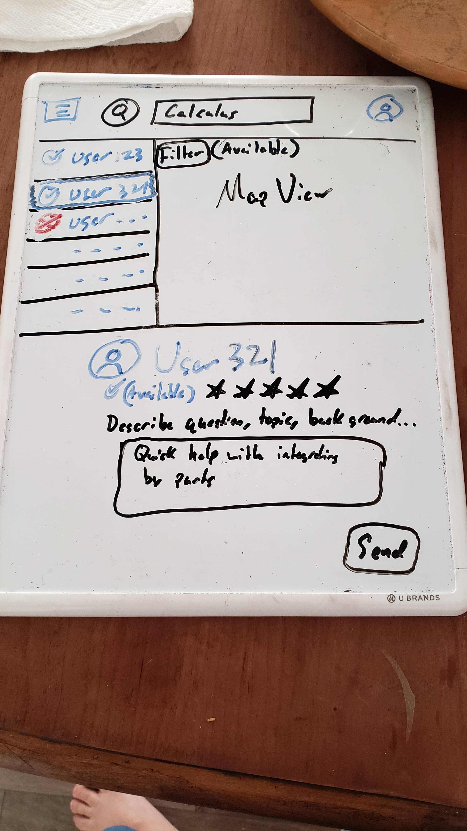
Filter Button
*Filter Button clicked*
Filter / sort search results by
-availability
-TimeZone
-Nearest Zipcode

